Slide 1
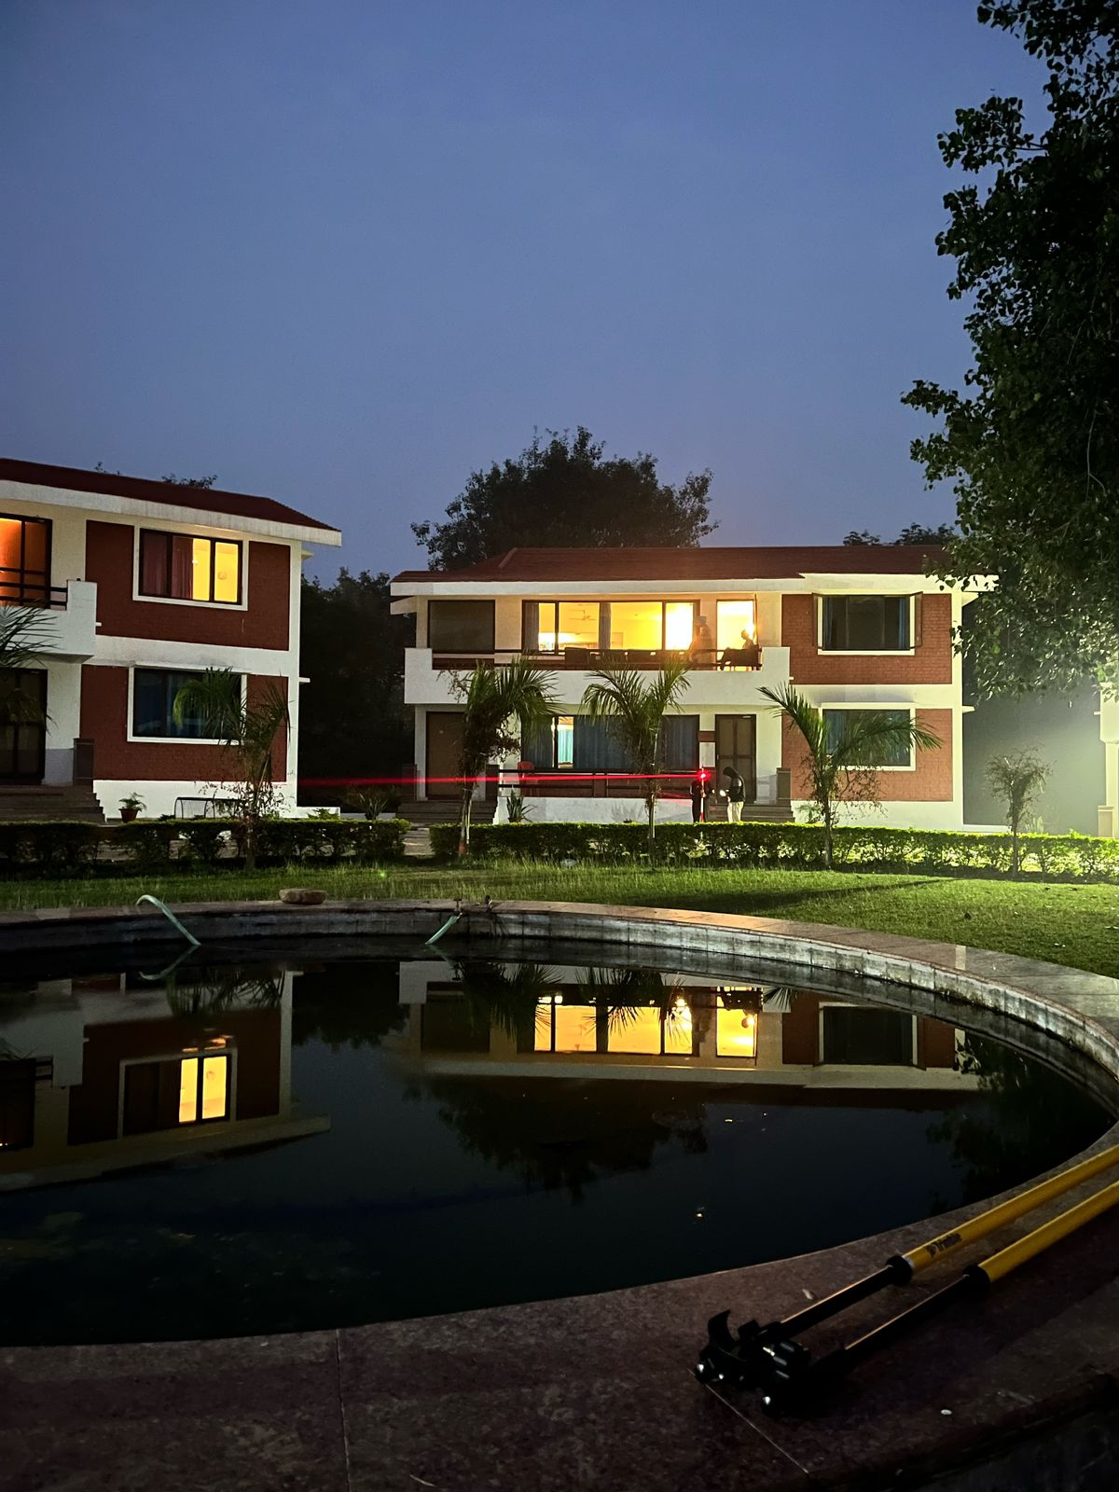

CE 673A Instrumentation laboratory and field practices
Ajay S (231030003)
Manoneet Gawali (231030035)
Shreya Todmal (231030057)
Tenzing Thungon (231030063)

Slide 2

agenda
Introduction​
Control Network Setup
Reconnaissance
GNSS Traversing
Levelling
Feature mapping
Deliverables
Lab work
Chain and Compass survey
EDMI Calibration
TS Traversing

Slide 3
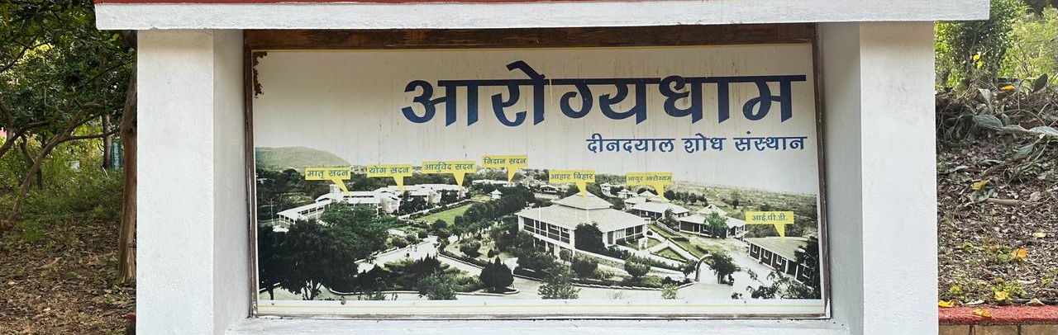
Introduction
The CE673A Instrumentation Laboratory and field practices in Geoinformatics project encapsulated an immersive one-week expedition into the heart of Aarogydham Chitrakoot area, Madhya Pradesh, commencing on November 28th, 2023. This endeavor aimed at learning practical skills in Geoinformatics, instrumental surveying techniques ​

Slide 4
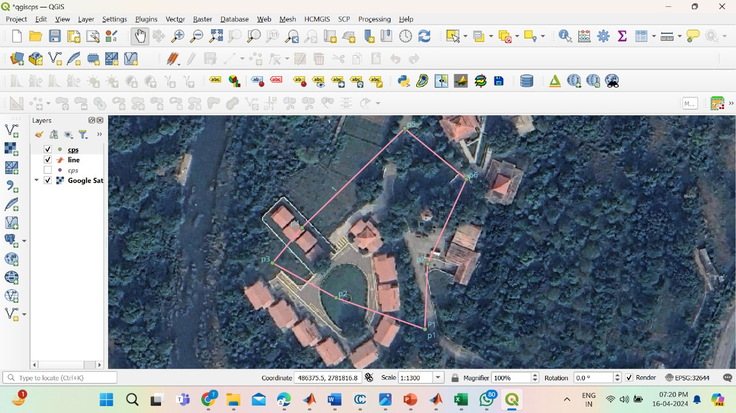
Control network setup
Reconnaissance survey
Control Network:
Criteria for CP selection:
Intervisibility between two CP
Open to sky
Maximum area coverage
Point should not be in busy location
Number of CP: 7
fig: CPs displayed in ArcGis Pro

Slide 5

Control network setup
GNSS traversing
Transit rule:
Northing adjustment for each point = ($\frac{ \text{∆}\text{N} \text{for} \text{traverse} \text{line} \text{to} \text{point}}{\text{∑∆}\text{N}}$) * Northing closure error
Easting adjustment for each point =
($\frac{ \text{∆}\text{E}\text{for} \text{traverse} \text{line} \text{to} \text{point}}{\text{∑∆}E}$) * Easting closure error
Readings: Static mode by R10 GNSS receiver
Post processing: TBC processing
Accuracy
Preprocessing:
Postprocessing:
e/p ratio: 1:203563 (first order class of 1:25000)
Fig: R10 GNSS receiver in rover and base mode

Slide 6
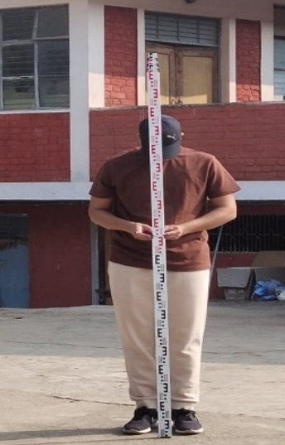
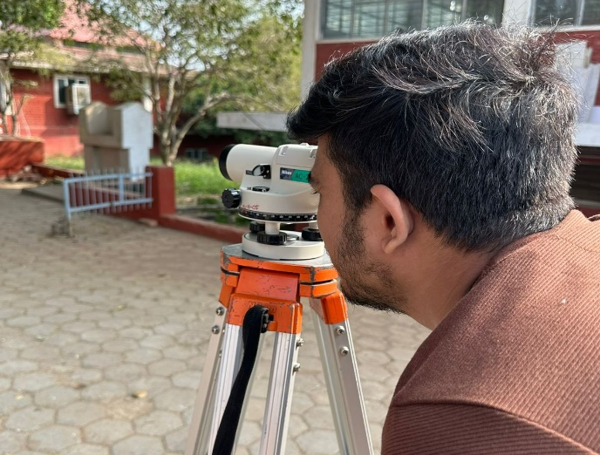
Control network setup
Levelling by auto level
Method of levelling: HI method
Closing error: 0.005 m
Classification: Precision levelling (C: 2.639)
Fig: Surveyor using Auto level and holding staff
BS | FS | HI | RL | Remark
0.975 |  | 100.975 | 100 | BM
0.54 | 1.335 | 100.18 | 99.64 | CP1
0.76 | 2.875 | 98.065 | 97.305
1.22 | 2.16 | 97.125 | 95.905 | CP2
0.81 | 1.39 | 96.545 | 95.735
2.83 | 1.65 | 97.725 | 94.895 | CP3
1.71 | 1.085 | 98.35 | 96.64 | CP4
3.765 | 4.38 | 97.735 | 93.97 | CP5
2.665 | 0.955 | 99.445 | 96.78
1.325 | 0.365 | 100.405 | 99.08 | CP6
1.285 | 1.385 | 100.305 | 99.02 | CP7
1.305 | 0.88 | 100.73 | 99.45
 | 0.725 |  | 100.00
Purpose: Determine Orthometric height of CP
Correction: loop closure as function of distance
Table : reduced level of CPs

Slide 7
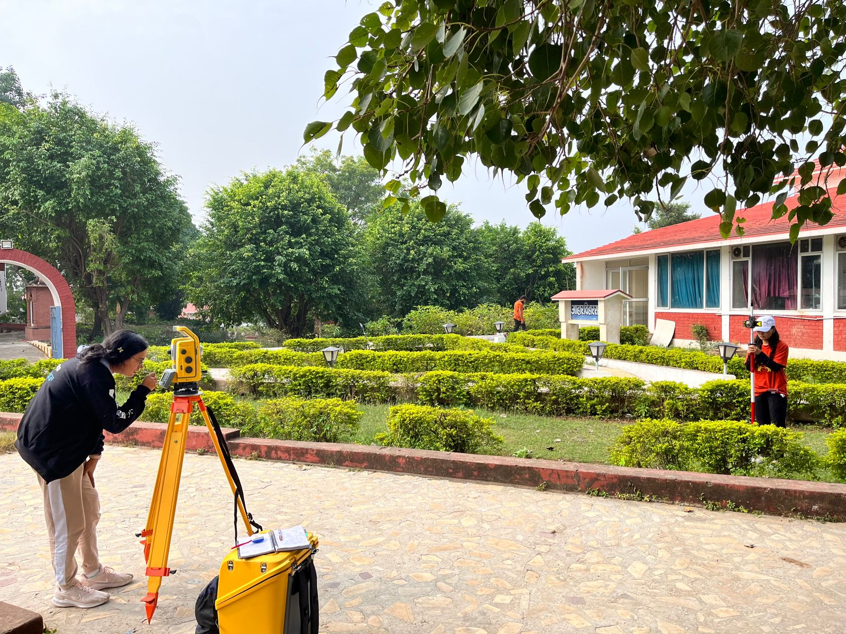
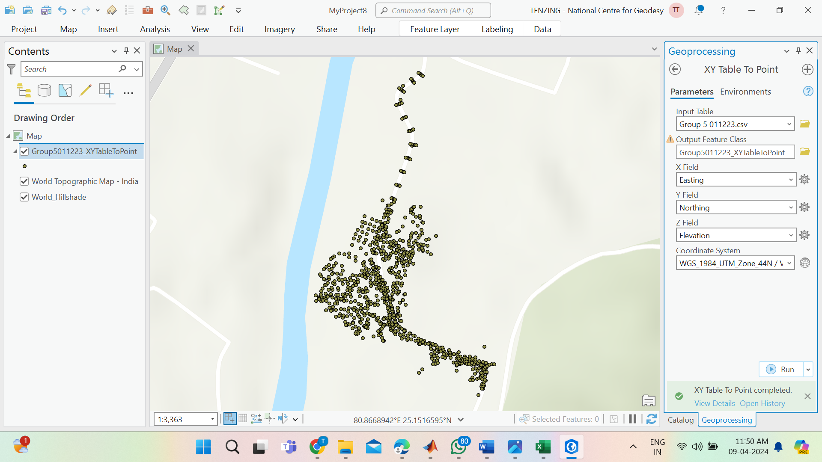
Control network traversing
Feature mapping by total station
Oriented by back-sighting the previous CP
N, E are added for CP, while orthometric height obtained by Auto level is added in elevation
Purpose: Determine co-ordinates for feature mapping
Fig: TS reading by target staff for contour data
Point | Easting (m) | Northing (m) | Elevation (m)
p1 | 486246.8 | 2781781 | 90.214
p2 | 486195 | 2781799 | 86.332
p3 | 486157 | 2781820 | 85.1
p4 | 486174.5 | 2781842 | 87.198
p5 | 486237.1 | 2781901 | 84.555
p6 | 486271.4 | 2781871 | 89.658
p7 | 486247.6 | 2781820 | 89.999
Fig: Data points in Arc GIS

Slide 8
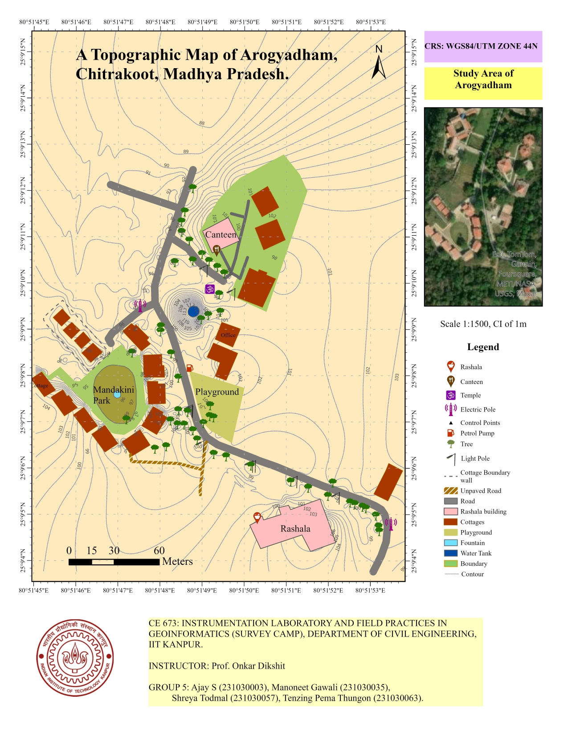
Deliverables
Topographic map
Topographical map of Aarogyadham digitized on Arc GIS
Scale : 1: 1500 (Large scale map), 1 cm on map is 15 m on ground
Plottable error: 37.5 cm
Contour interval: 1m (rolling terrain)
CRS: WGS 84, UTM zone 44
Fig: Topo map of Aarogyadham digitized on Arc GIS

Slide 9
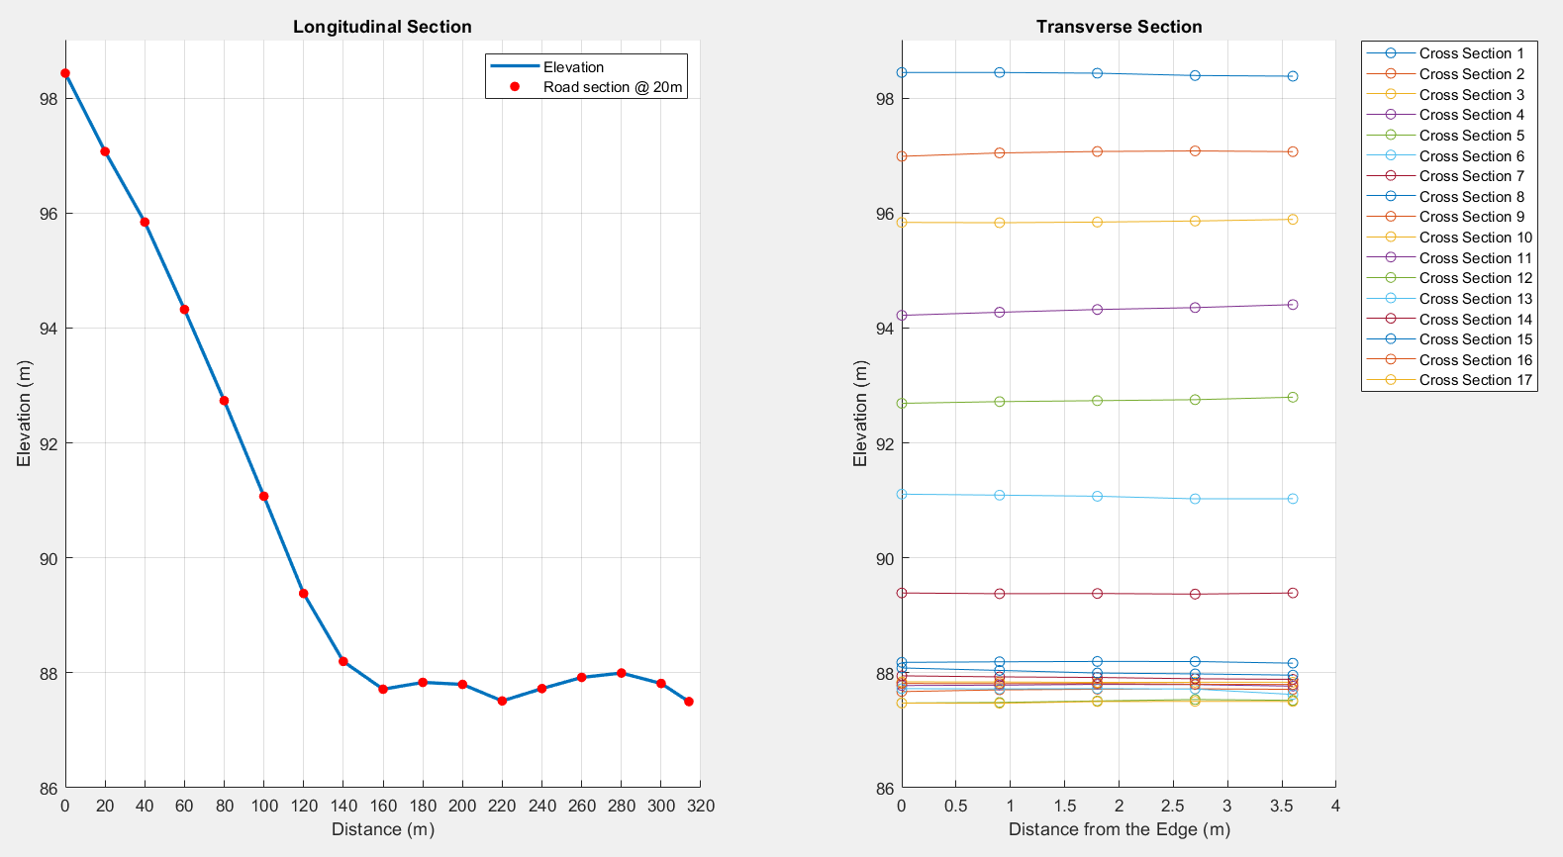
Deliverables
Road profile
Ground preparations:
Section at 20 m interval
Divide each section in 5 parts, 0.9m each, width of road is 3.6m
Purpose: Insight about the change in elevation w.r.t. length of the road
Fig: Road profile

Slide 10
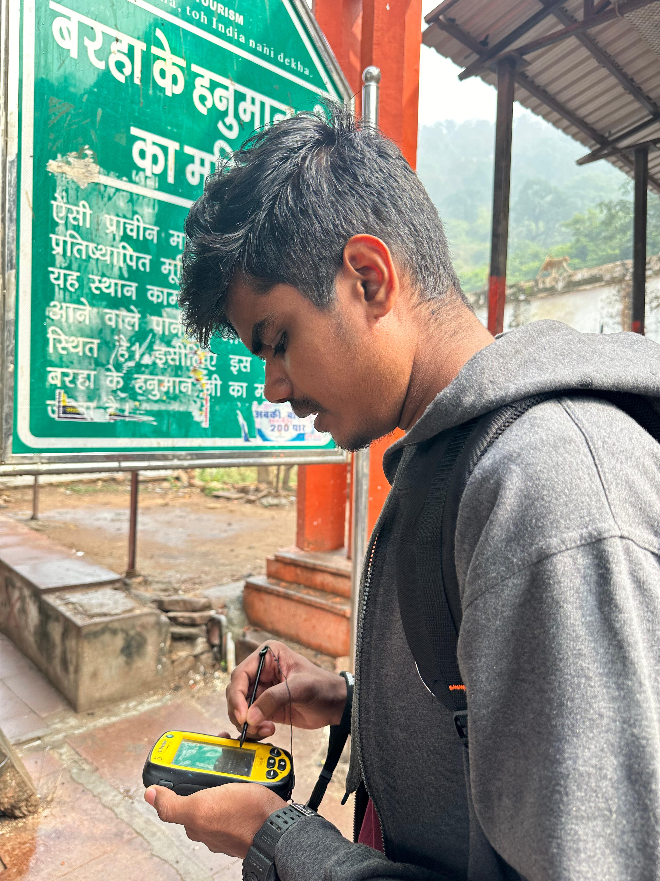
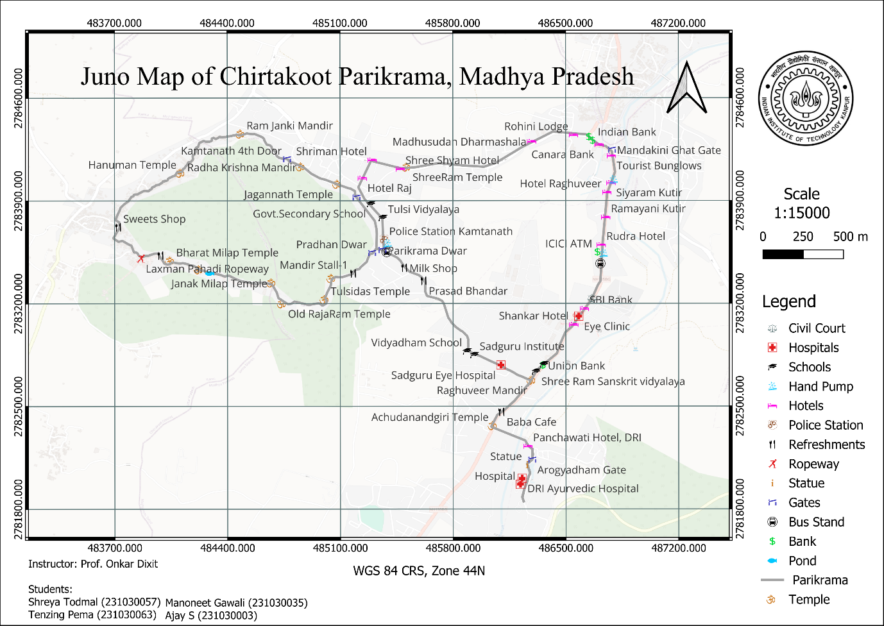
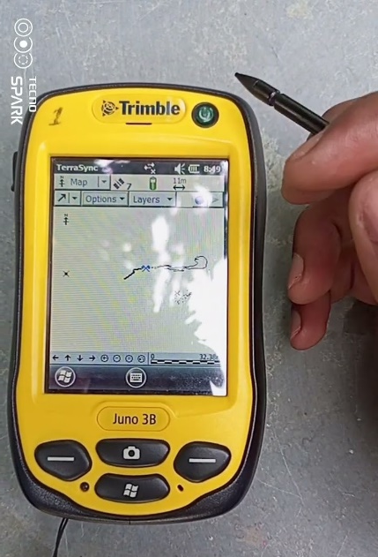
deliverables
JUNo survey
Fig: Surveyor using Juno 3B
Scale : 1: 15000 (Large scale map), 1 cm on map is 150 m on ground
Plottable error: 3750 cm
CRS: WGS 84, UTM zone 44
Fig: Navigational map of Chitrakoot Parikrama digitized on Q GIS

Slide 11
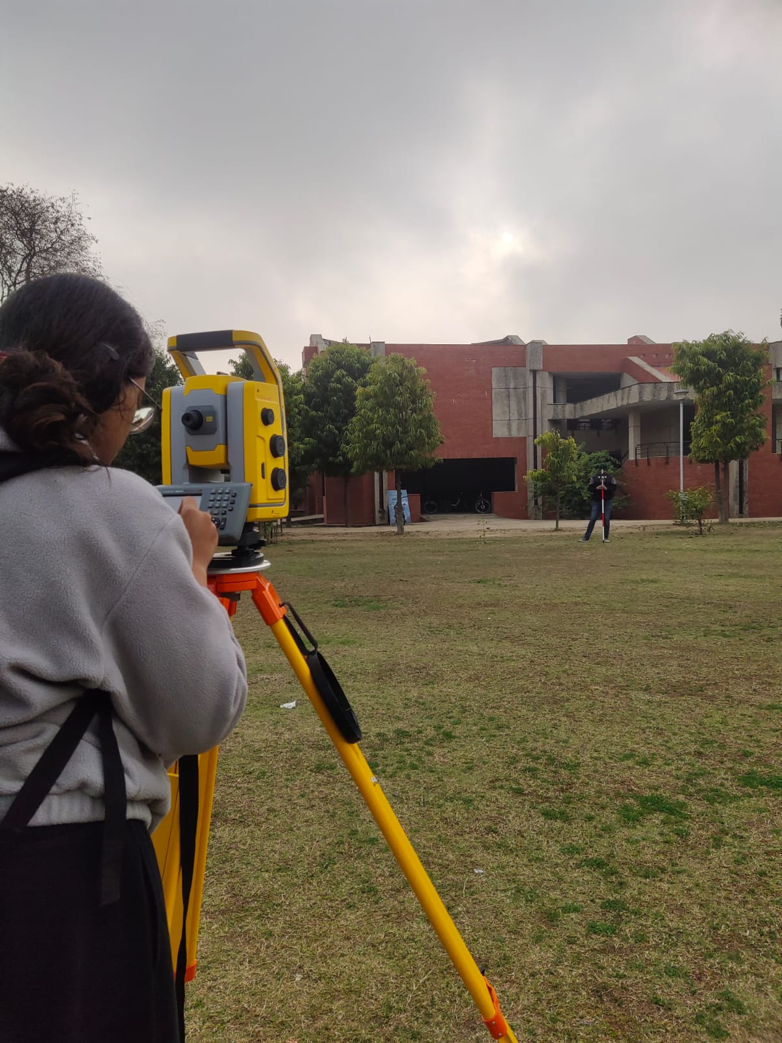
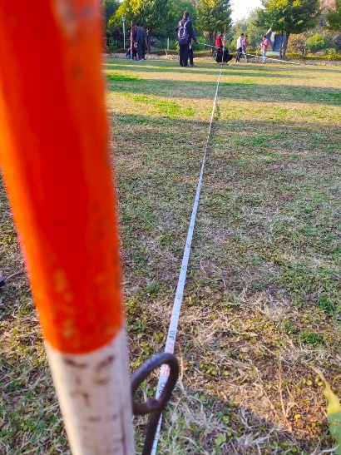
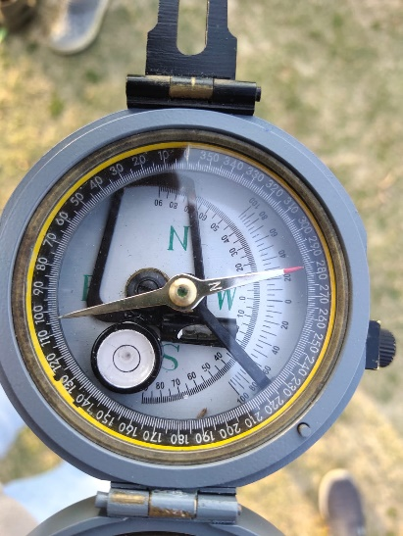
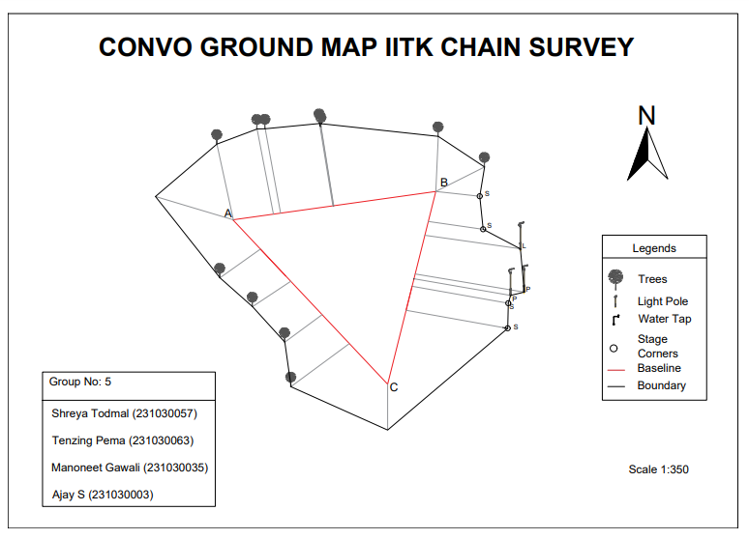
Lab works
Chain and compass survey
Fig: Main station setup and prismatic compass
Close traverse plotted by both linear and angle measurements
Graphical method is used for correction
Three main stations are set up A, B,C
Fig: Convo ground map by chain and compass surveying

Slide 12
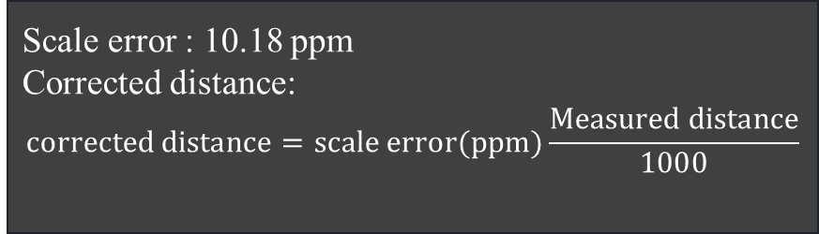

Lab works
EDMI calibration
Distance by EDMI:
Taped dist di( m) | taped distance | EDMI dist, Di (m) | Do + Sd (m) | Di-(D0+sum(d)) (m) | Correction (m) Cyclic error | Corrected distance
20 | 0 | 19.995 | 20 | -0.005 | 0.0045 | 19.77905
21 | 1 | 20.997 | 21 | -0.003 | 0.0042 | 20.77023
22 | 2 | 21.993 | 22 | -0.007 | 0.0035 | 21.75548
23 | 3 | 22.996 | 23 | -0.004 | 0.0035 | 22.74764
24 | 4 | 23.991 | 24 | -0.009 | 0.0026 | 23.7319
25 | 5 | 24.989 | 25 | -0.011 | 0.0024 | 24.71912
26 | 6 | 25.988 | 26 | -0.012 | 0.0023 | 25.70733
27 | 7 | 26.988 | 27 | -0.012 | 0.0023 | 26.69653
28 | 8 | 27.994 | 28 | -0.006 | 0.0017 | 27.69166
29 | 9 | 27.994 | 29 | -1.006 | -0.0083 | 27.69166
30 | 10 | 29.993 | 30 | -0.007 | 0.0016 | 29.66908
$$2D=mλ+\frac{φ}{2π}λ+k$$
Purpose:
Determine cyclic error
Reflector instrument constant
Scale error
Scale error : 10.18 ppm
Corrected distance:
$$corrected distance=scale error(ppm)\frac{Measured distance}{1000}$$
Table : EDMI corrected distance by cycle error and scale error

Slide 13
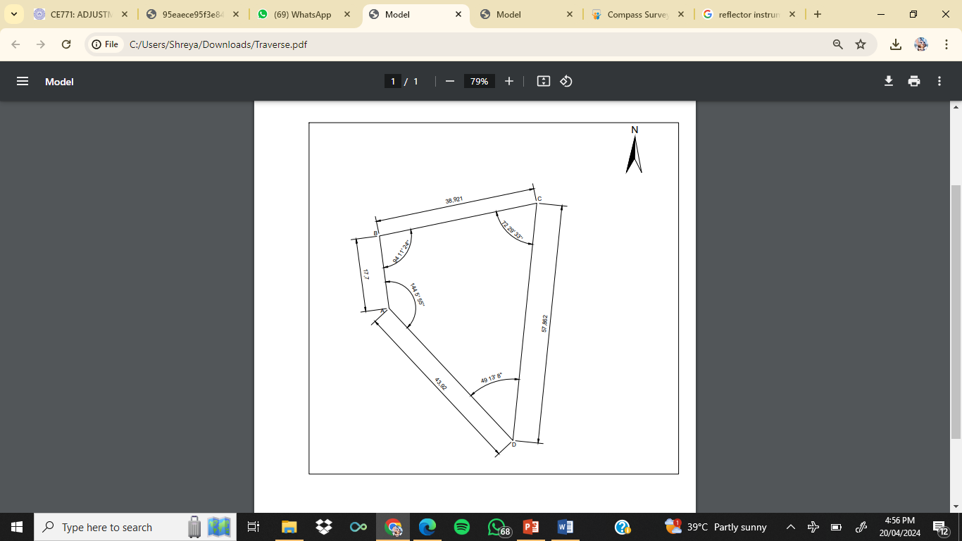
Lab works
Total station traversing
Station Observed | Face L/R | Horizontal Angle |  |  |  | Succesive difference | Adjusted angle
 |  | Reading (Degrees) | Mean of interior angle | Multiples of average corrections | Correction rounded
A | L | 0 | 144.086235 | 0.012 | 0.0125 | 0.0125 | 144 5' 55''
D |  | 144.1572
A' |  | 0.0025
Error |  | -0.0025
A | R | 180
D |  | 324.01527
A' |  | 179.9991
Error |  | 0.0009
B | L | 0 | 94.177625 | 0.249 | 0.025 | 0.0125 | 94 11' 24''
A |  | 94.17805
B' |  | 0.0011
Error |  | -0.0011
B | R | 180
A |  | 274.1772
B' |  | 180.01694
Error |  | -0.01694
C | L | 0 | 72.479995 | 0.0374 | 0.0375 | 0.0125 | 72 29' 33''
B |  | 72.47777
C' |  | 0.0025
Error |  | -0.0025
C | R | 180
B |  | 252.48222
C' |  | 180.00111
Error |  | 0.00111
C | L | 0 | 49.206385 | 0.0499 | 0.05 | 0.0125 | 49 13' 8''
D |  | 49.16694
C' |  | 0.003888
Error |  | 0.003888
C | R | 180
D |  | 229.24583
C' |  | 180.03888
Error |  | 0.03888
 |  |  |  |  |  | 0.05 | 360 0' 0''
Table : TS traverse corrections
Fig : Traversing of convo ground by TS

Slide 14
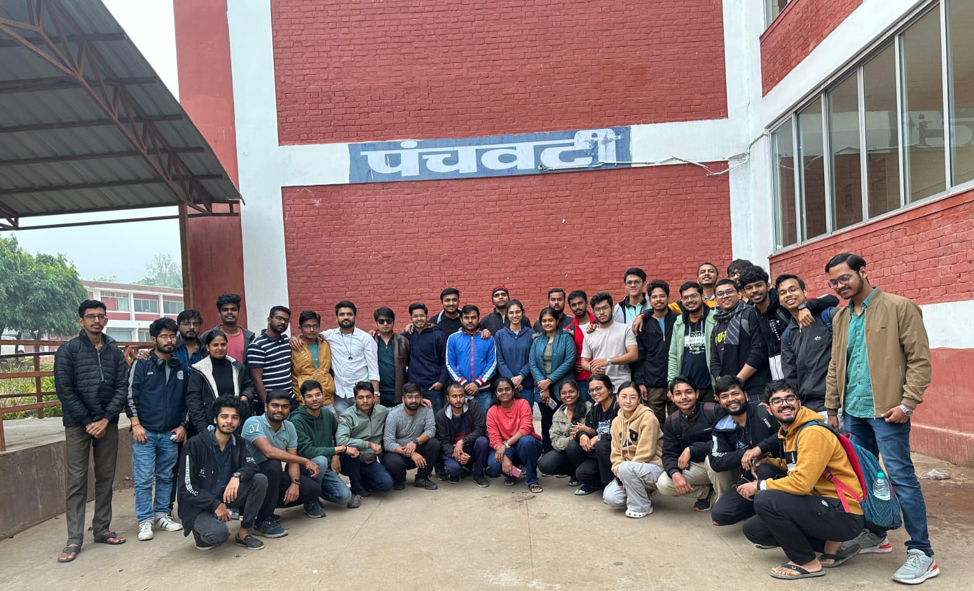
Thank you
Prof. Onkar Dikshit
Hari Babu Prajapati Sir
Shitla Tripathi Sir
Ram Keval Maurya Sir
TAs
​

